Slide 1
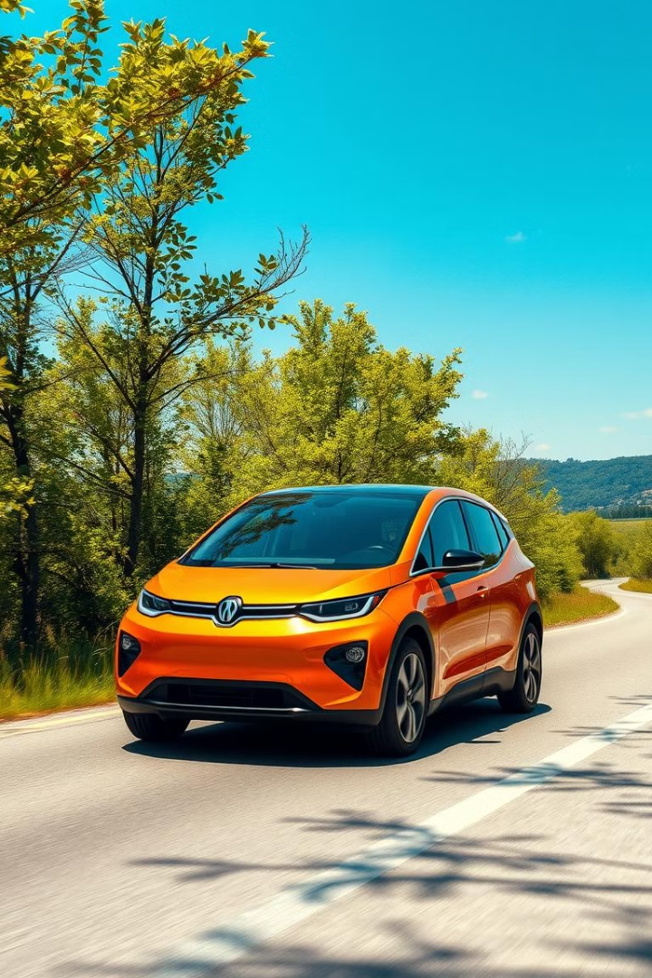

Are Electric Vehicles a Good Option?
The rise of electric vehicles (EVs) presents a compelling alternative to traditional gasoline-powered cars, offering potential benefits and challenges that require careful consideration.
by Daksh Patel

Slide 2

Introduction to Electric Vehicles (EVs)
1
Battery-Powered Propulsion
2
Zero Tailpipe Emissions
EVs are powered by electric motors that draw energy from rechargeable batteries, eliminating the need for gasoline engines.
EVs produce no tailpipe emissions, contributing to cleaner air and reducing greenhouse gas contributions.
3
Regenerative Braking
EVs use regenerative braking systems to capture energy during deceleration, improving efficiency and extending battery range.

Slide 3

Benefits of Owning an EV
Reduced Fuel Costs
Lower Maintenance Needs
EVs utilize electricity for power, which generally costs less than gasoline, saving money on fuel expenses.
EVs have fewer moving parts than traditional cars, leading to reduced maintenance requirements and associated costs.
Quiet Operation
EVs run silently, providing a peaceful and enjoyable driving experience, especially in urban areas.

Slide 4

Reduced Emissions and Environmental Impact
1
Reduced Greenhouse Gas Emissions
EVs eliminate tailpipe emissions, significantly contributing to the reduction of harmful gases like carbon dioxide.
2
Improved Air Quality
EVs contribute to cleaner air in urban environments by reducing the release of pollutants from internal combustion engines.
3
Sustainable Transportation
EVs promote a more sustainable approach to transportation by reducing reliance on fossil fuels and minimizing environmental impact.

Slide 5
Lower Fuel and Maintenance Costs
Electricity vs. Gasoline
Reduced Maintenance Requirements
Long-Term Cost Savings
Electricity is generally less expensive than gasoline, resulting in lower fuel costs for EV owners.
Over the long term, the combined savings on fuel and maintenance can significantly reduce the overall cost of owning an EV.
EVs have fewer moving parts than gasoline cars, reducing the frequency and cost of maintenance.

Slide 6
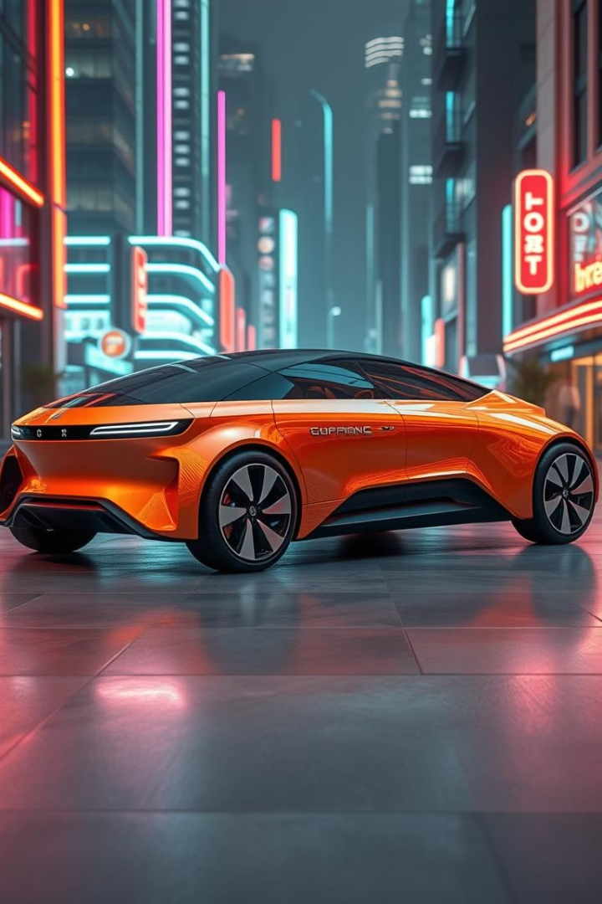



Advancements in EV Technology
Battery Range and Performance
EV battery technology is rapidly evolving, offering greater range, faster charging times, and improved performance.
Charging Infrastructure
Public and private charging stations are expanding, providing greater accessibility and convenience for EV owners.
Autonomous Driving
Advancements in autonomous driving technology are being integrated into EVs, paving the way for self-driving cars.

Slide 7

Challenges and Considerations
Battery Range
EVs currently have a limited driving range compared to gasoline cars, requiring careful planning for long trips.
Charging Time
Charging an EV can take longer than filling a gas tank, especially for larger batteries, requiring time management and planning.
Initial Cost
EVs can have a higher upfront cost compared to traditional cars, although this gap is closing as prices decrease.

Slide 8




Charging Infrastructure and Accessibility
Public Charging Stations
Public charging stations are becoming more common, providing access to electricity for EV owners while away from home.
Home Charging
Home charging is often the most convenient and cost-effective option, allowing for overnight charging.
Workplace Charging
Some employers offer workplace charging stations for employees who drive EVs, providing a convenient charging option during the workday.

Slide 9

Incentives and Government Support
1
Tax Credits and Rebates
2
Infrastructure Development
Many governments offer tax credits and rebates to encourage the purchase of EVs, reducing the initial cost for buyers.
Governments are investing in the development of charging infrastructure, expanding the network of public charging stations.
3
Research and Development
Governments are supporting research and development efforts to advance EV technology and improve battery performance.

Slide 10

Outlook and Future Trends for EVs
1
Growing Adoption
EV sales are expected to continue growing as technology advances and prices become more competitive.
2
Increased Range and Performance
Battery technology is improving, leading to longer ranges, faster charging times, and enhanced performance.
3
Autonomous Driving Integration
Autonomous driving technology is being integrated into EVs, creating a future of driverless and connected vehicles.

